Slide 1
WHAT CAN YOUR
COMMUNITY FOUNDATION
DO FOR YOU?
Notes:
Hello our names are……we are volunteers with Mercer County Community Foundation
We are out sharing our message so we can draw more of the community to awareness and connection through the fund.
We would like to ask you to consider how you or a group you know, might team up with us to make our foundation more impactful for all of us. It is also good information in case someone asks you how to connect with us.

Slide 2
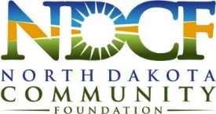
Focus
Permanent Endowment Fund, managed by the North Dakota Community Foundation
Granting Purpose for Area Nonprofits and Governmental Agencies
Community Foundation
Locally-led: Local leaders make funds available
Charitable-Giving Services for those who Want to take advantage of the State Tax Credit—Or other methods of benefitting their community
Notes:
We are going to cover (4) key areas of our foundation.

Slide 3
Magic of Endowment: Permanent
Retained Market Value of $100,000
Invested on 12/31/1989 (based on 5% total spending – 4% grant + 1% admin fee):
* Fund Value in 2018: $146,498.84
* Total $ given in grants: $159,169
Notes:
The fund is a permanent endowment which means it is invested to last many years into the future. 4% per year is given from the fund as “Grants” to the community.
Currently our fund is $13,000 and gives out roughly 4% of the fund value per year valued each Dec 31st. We can take donations from many sources to grow our fund. And gifts qualify for charitable deductions.
This chart is of an actual $100,000 with no additional contributions.
Note the fund is subject to market changes…However
--The grants given were $159,000 and still the fund grew to $146,489
--The funds are invested with (6) different North Dakota brokers. (American Trust, First International, Bremer Trust, Wells Fargo, Bell State) and overseen by NDCF.

Slide 4
Granting Purpose: A Stronger Community
Donations, Fundraisers, Estate Gifts, Gambling Proceeds
Community’s Permanent Fund
Annual Grants
Notes:
Fund has broad granting authority.
The Grants are general: Grants can go to any qualified 501c3 or governmental entity or sub-division. (Parks and Rec, Social Services, Food Pantry, EMS, Hospital, Economic Dev project or the like.
---The fund covers the whole county.
Granting each year follows a formal application process. Our committee of county leaders reviews applications, then awards based on the greatest need, and worthiest project of that year. This changes year to year.
--The fund will become more impactful as the fund grows from contributions.
4) Fund does not compete with current non-profits, since it allows donors who are interested in many aspects of the community to give. It works along-side other non-profits. Many of those same non-profits can benefit from the fund when they have important projects.

Slide 5
Donor Benefit: 40% State Tax Credit
  Gifts over $5,000 by Individuals or businesses giving any amount, in or out of state, that pay ND income tax, are eligible for a 40% ND income tax credit. Limits Apply. Gifts of all sizes and types are acceptable.
Gift Amount | $5,000 | $10,000 | $25,000 | $50,000
Federal Tax Savings * | ($960) | ($1,920) | ($4,800) | ($9,600)
ND State Income Tax Credit | ($2,000) | ($4,000) | ($10,000) | ($20,000)
Net Cost of Gift | $2,040 | $4,080 | $10,200 | $20,400
*For the 32% Tax Bracket
For illustration purposes only – consult your tax advisor
Notes:
Any size gift can be given…however,
To help grow these funds, the state instituted the 40% ND tax credit available to anyone earning income from North Dakota, in or out of state, and giving at a certain level.
--Businesses any amount
--Individuals or couples $5,000 or more to one fund
2) Note the cost of the gift is reduced as shown in the chart
4) Federal benefits vary with new 2019 changes, however we always instruct potential donors to ask their planners to run numbers to get exact benefits.

Slide 6
Community Fund Examples:
Fund | Year Started | Current Assets* | Available to Grant
Drayton Area Community Foundation | 2005 | $87,718 | $3,522
Bowman & Slope County Community Foundation | 2014 | $166,946 | $4,813
Richardton Area Community Foundation | 1981 | $404,169 | $16,057
Carrington Community Endowment Fund (includes McGinn-Kunkel estate) | 1980 | $521,259 | $20,471
Minot Community Endowment Fund (includes Westlie & Solheim) | 1981 | $1,544,803 | $64,371
Clarence Johnson & Eunice Iwen Community Foundation for Arthur, ND | 2005 | $5,886,042 | $246,684
* Data as of 12/31/18
Notes:
This is a few examples of the overall 65 communities who have these funds and the grants they are giving yearly.
Clarence Johnson was created through an estate gift.

Slide 7
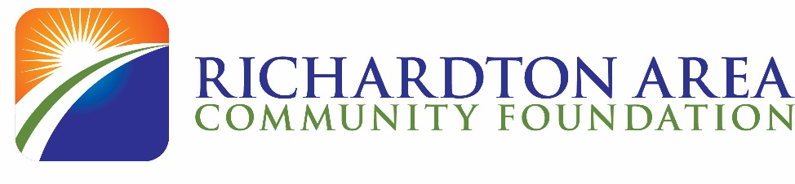
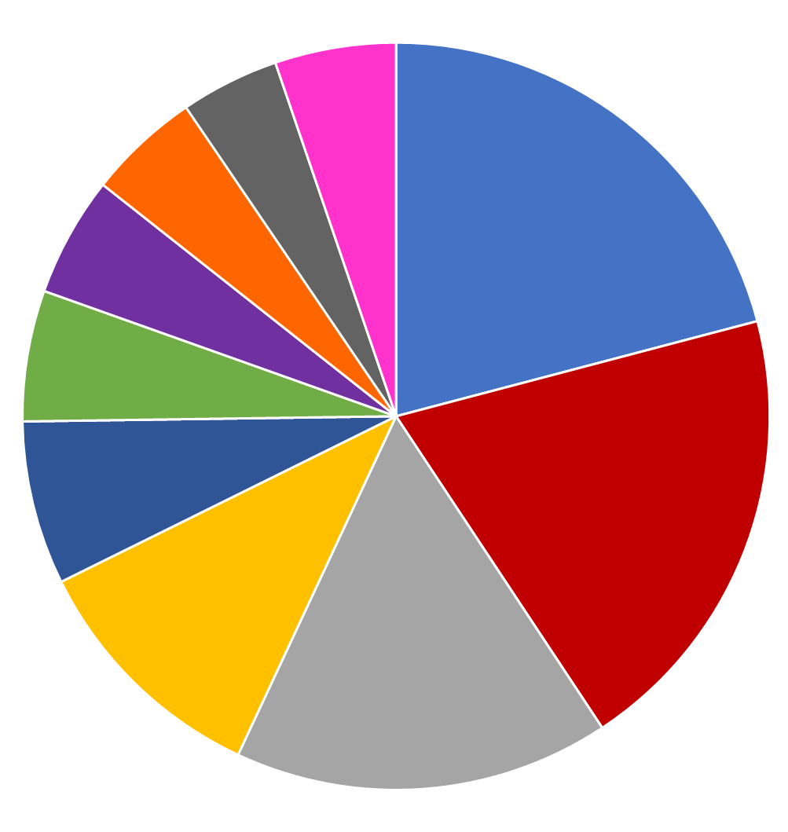
An Example of Another Foundation’s Success:
History of the Richardton Area Community Foundation:
Established in 1981
Current Assets (as of 3/31/19): $437,039
Total Grants Awarded: 254 grants, totaling $234,803
Total grants over the years:
All Others - 5%
Richardton Park District | $49,078
Richardton/Taylor Schools & Youth Groups | $46,475
Richardton Health Center | $38,175
City of Richardton | $25,223
Projects at Area Churches | $16,633
American Legion | $13,299
Camp ReCreation | $12,198
Fire Department | $11,400
Senior Citizens Center | $10,025
All other grantees | $12,297
 | $234,803
Seniors - 4%
Fire - 5%
Park District
21%
ReCreation - 5%
Legion - 6%
Churches - 7%
Schools & Youth Groups
20%
City of Richardton 11%
Health Center
16%

Slide 8
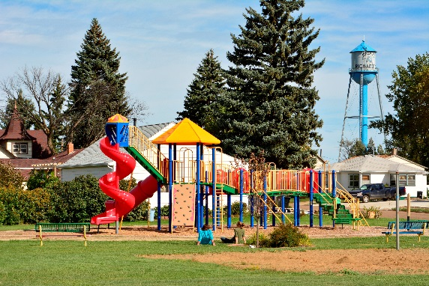
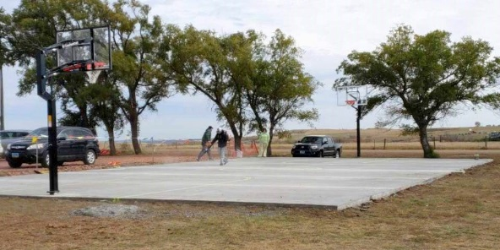
Here’s what the Richardton Area Community Foundation Helped Fund in the last Three Years:
Richardton Health Center, Inc. - John Deere Snow Blower Attachment
Richardton Lions Club - Community Sign
Richardton Park District - Little League Batting Machine
Richardton Rural Fire Protection District - Purchase Tanker-Pumper Truck
Richardton-Taylor Public School District #34 - National Speech & Debate Tournament
Taylor Community Activities - Restoration Work on Grandvale School #3
American Legion Auxiliary - Kitchen Repairs
American Legion Post #180 - Building Repairs
Richardton Saddle Club - Repairs to Rodeo Arena
Richardton Park District - Richardton Youth Baseball Age 13/14 Program
St. John Lutheran Church - Construct Disability Bathroom & Ramp for Church
American legion electrical update to meet current electrical codes.
PAWS (Richardton-Taylor School District) - Multipurpose Outdoor Court
Richardton Park District - St Mary's Basketball Court

Slide 9
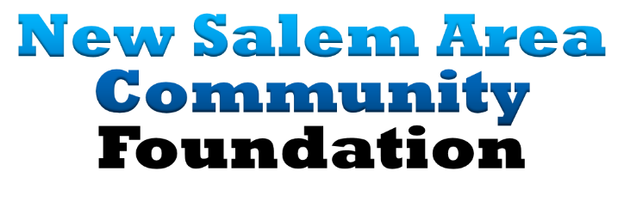
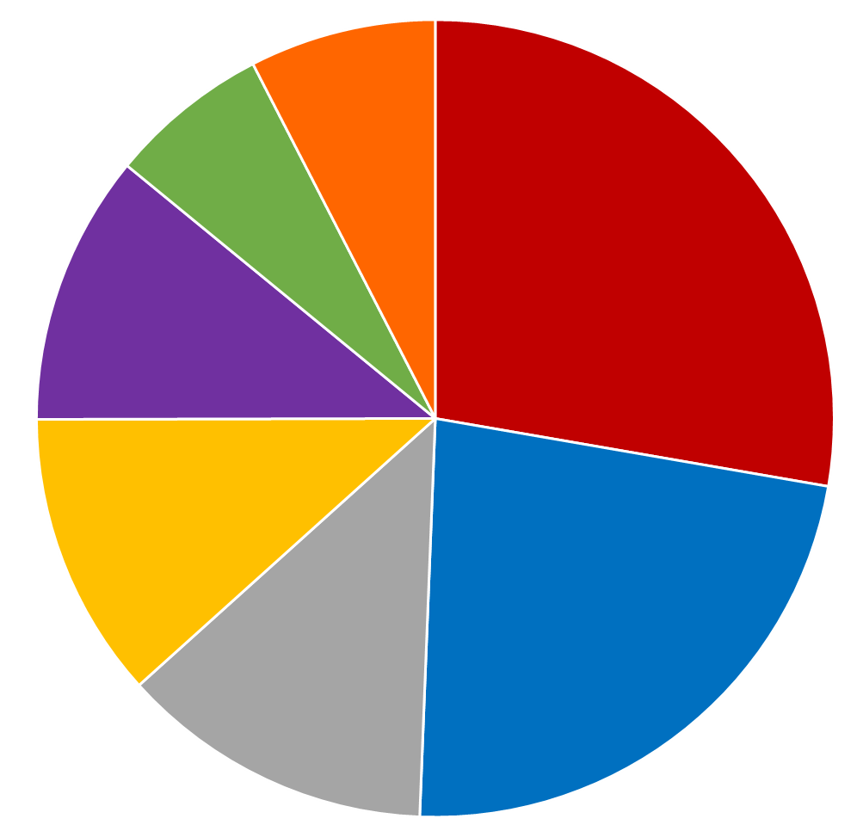
An Example of Another Foundation’s Success:
History of the New Salem Area Community Foundation:
  Established in 2013 with a gift from the New Salem Area Credit Union
  Current Assets (as of 3/31/19): $1,361,333
  Total Grants Awarded: 35 grants, totaling $419,093
  Total grants over the years:
All
Other
7%
Elm Crest 6%
Emergency
Response
(Fire/Ambulance)
28%
Emergency Response (Fire/Ambulance) | $116,197
New Salem/Morton County Parks | $95,969
City of New Salem | $53,252
New Salem Fitness Center | $48,750
New Salem/Almont Schools & PreSchool | $45,975
Elm Crest Manor | $27,250
All other grantees (5) | $31,700
 | $419,093
Schools
11%
New Salem
Fitness Center
12%
New Salem & Morton County Park Districts
23%
City of
New Salem
13%

Slide 10
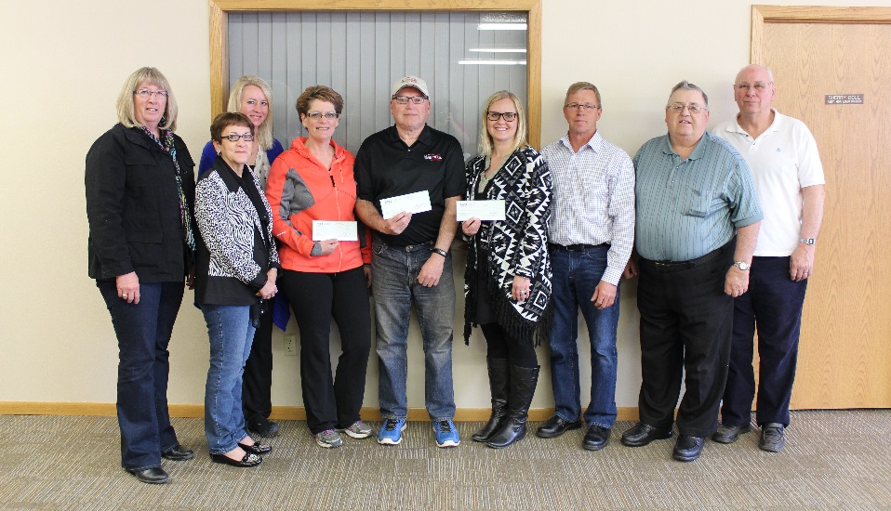
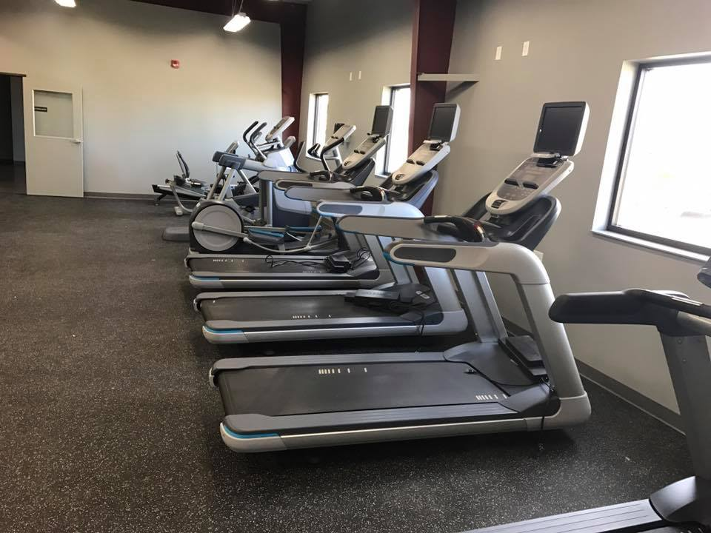
Here’s what the New Salem Area Community Foundation Helped Fund in the last Two Years:
New Salem Preschool
Playground Equipment at North Park
Prairie View Playground
US Flags on Main Street
Fish Creek Shelter Repairs
Summer Safety Trainings and Equipment
New Mobile Radios for Fire District
Community Movie Night
Patio and 2 Golf Carts for Red Trail Links
2015 Grantees receive their grant awards from New Salem Area Community Foundation Advisory Committee members.
The New Salem Area Community Foundation awarded over $48,000 in grants toward the construction of the new fitness center in New Salem.

Slide 11
Locally Operated: Community Conduit
Philanthropist
Grantmaker
Connector
Networker
Community Impact Roles
Story Teller
Conduit to Business
Project/
Needs
Expert
Organizer
Notes:
Even though we retain support from our Regional NDCF person out of Dickinson, we have a committee of 10 community leaders from various positions in Mercer County who own the processes of the local foundation.
One of our main roles, among many, is “marketing” or storytelling…informing the community of why we exist.
3) Finally, another role is to work with the community to grow the fund so we can fund the growing needs in the community in the future.
4) Through these roles, we act as a conduit between the fund and the community…For those wanting to give, and those making application for grants. We work together as a team to make our fund impactful.

Slide 12
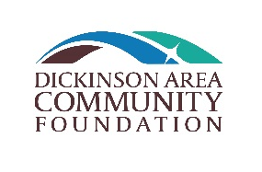
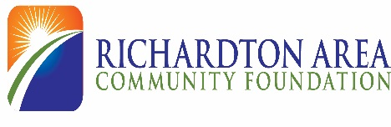
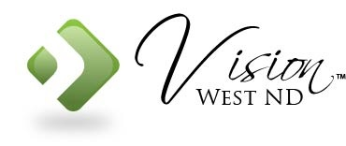

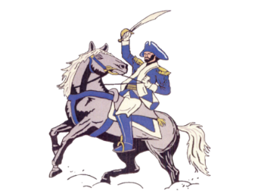



Other Fund Tools for Community Philanthropy
Community Endowment Funds (67)
  Grants serve specific geography
Scholarship Funds (100+)
  Dickinson: Springer DHS/THS $30+K per year
Donor-Advised Funds (40+)
  Donor or family decide grants
Agency Endowment/School Funds (75)
  (10) Schools in western ND
  Supports a specific charity or organization: Vision West, ND Able Inc, Sacred Heart Monastery, United Way: Dickinson, Killdeer Ambulance
Notes:
Even thought a Community fund is the most versatile, because is can serve many community projects, Sometimes it happens donors don’t want to give to the community general fund. In these cases we have the support of NDCF to set up new funds.
The key, is helping community members ask “how can I help” and our committee will help make the connections needed, to allow them to benefit their community through charitable giving.
--This slide shows the many options a donor has to give even if not giving to the endowment. There are over 700 funds with almost $90 million in assets benefiting communities across the state.
So donors, families, organizations like schools, or governmental agencies can have their own funds
Our committee supports the community-- Donors, Non-profits, Government Agencies; to grow and retain value for sustainable Community services.

Slide 13
QUESTIONS

Slide 14
Powers Lake Community Foundation
Advisory Committee
Kevin Carlson (Chair)
Kari Enget (Vice-chair)
Sonja Tinjum (Secretary)
Jennifer Titus (Treasurer)
Mark Douts
Dennis Dosch
Elda Titus
Jessica Bullinger
Contact:
PowersLake@NDCF.net
NDCF.net/PowersLake
Notes:
As we mentioned in the opening, if there are questions or comments or ideas or if you hear of someone wanting to benefit their community but not sure how, please connect us. Imagine what our community could be doing with $10,000 a year of new dollars annually.

Slide 15
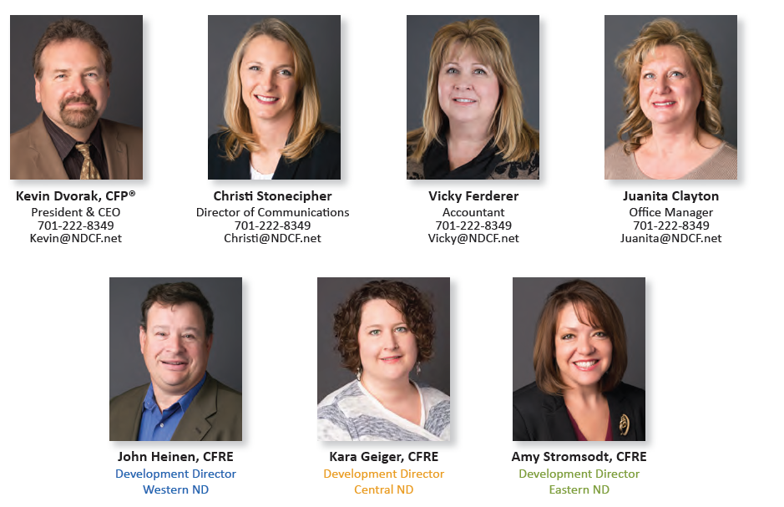
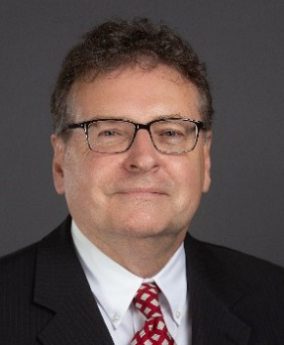
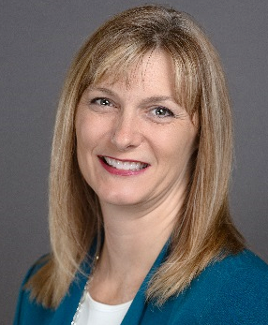
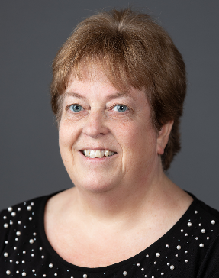
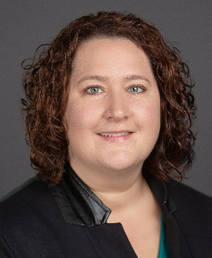
NDCF State & Regional Support
Deb Clark
Office Manager
701-222-8349
Deb@NDCF.net
Notes:
The team that backs us up when questions about charitable giving, or specific assets, or more on strategy for growing out fund come up. They are always there to support us. John is our Regional contact.

Slide 16

“What a man does for himself, dies with him. What he does for his community lives long after he is gone.”
- Theodore Roosevelt
What will YOUR legacy be?

